Slide 1
COMP 51 Week Twelve
Classes

Slide 2
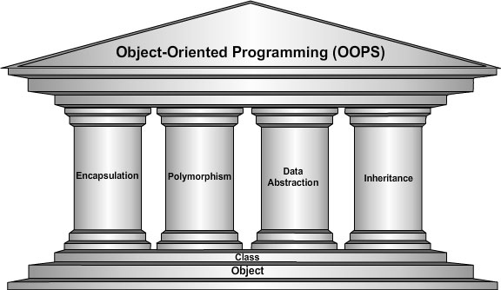
Learning Objectives – Intro to OOP

Slide 3
Why Do We Care
Launch Point for Object Oriented Programming!
Become software designers, not just hackers
Integrate with existing programs and platforms

Slide 4
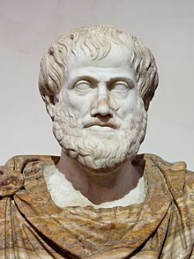
A Little History
I sat in my favorite chair
I played with my dog
Describe my chair
What is my dog’s name?
Chairs belong to a category of furniture = class
Dogs belong to a different category
But a Chair is not a dog
You can sit on a chair
My chair and my dog is an instance or object of their class
You should not sit on a dog

Slide 5
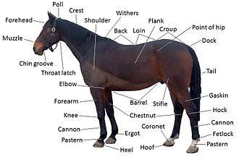

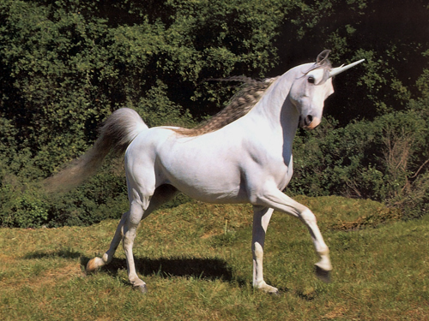
A Little Mythology
A horse has many properties or attributes
Notes:
We can extend the horse class.

Slide 6
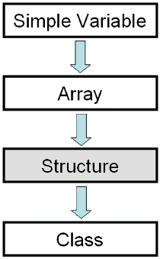
Structures
2nd aggregate data type: struct
Aggregate means "grouping"
Recall array: collection of values of same type
Structure: collection of values of different types
Notes:
A simple variable identifier can hold a single data element of any data type. Arrays can hold a grouping of related data items of the same data type using a single identifier. Structures allow you to group data items of different data types under the same identifier. Classes build on Structures by hiding the data and adding the ability to include member functions.

Slide 7
Structure Definition
Must define struct before use
Typically at global level
So what does this mean? ____________
No memory is allocated
Just a "placeholder" for what our struct will "look like"
Example: struct CDAccountV1 ←Name of new struct "type" { double balance; ← member names double interestRate; int term; };

Slide 8
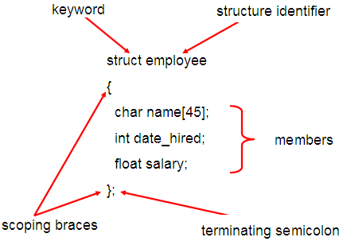
Structure Details
This is not the variable name . This represents a new data type

Slide 9
Structure Definition Practice
Write the structure definition that will hold a baseball player’s stats
Want to be able to track their name, batting percentage, number of home runs, triples, doubles, stolen bases, and on base percentage

Slide 10
Working with Structure Variables
Declaring Structures
Just like declaring simple types
The new variable contains "member values"
CDAccountV1 account;
Dot Operator to access members
account.balance
account.interestRate
account.term
Account2.balance
Variable account now of type CDAccountV1 with all of the parts
Called "member variables“. Different structs can have same members

Slide 11
Structure Practice Inventory Value Continued
Define a structure that maps to last week’s input file and output file formats
Declare a variable for the structure to hold the inventory data.
Update your program to save the inStream data to the structure
Update the outStream statement to print out the computed inventory value
If time, identify the item that has the largest value in stock (save this to a different variable)

Slide 12
Object-Oriented Design Guidelines
Design Guideline
All data should be hidden within its class
Ramifications:
Good: Can't mess up the state (compiler complains)
Good: Have to create interface of member functions
Bad: Extra coding, but worth it
Design Guideline
Keep related data and behavior in one place
Ramifications
Good: Provides intuitive collection of operations
Good: Reduces the number of arguments in messages
Bad: None that I can think of

Slide 13
Cohesion Concept
Synonyms for cohesion:
hanging together
unity, adherence, solidarity
Cohesion means
data objects are related to the operations
operations are related to the data objects
data and operations are part of the same class definition

Slide 14
Intro to Classes
Integral to object-oriented programming
Similar to structures
Adds member FUNCTIONS
Not just member data → merge code and data
Class Definition
class DayOfYear ← name of new class type { public: void output(); ← member function prototype! int month; int day; };
Notes:
Notice only member function’s prototype
Function’s implementation is elsewhere
Cohesion within a class
A class definition provides the public interface--messages should be closely related
The related data objects necessary to carry out a message should be in the class

Slide 15
Declaring Objects
Declared same as all variables
Predefined types, structure types
Example: DayOfYear today, birthday;
Objects include:
Data
Members month, day
Operations (member functions)
output()
Two objects declared with memory allocated

Slide 16
Class versus Instance
Basic explanation
http://www.youtube.com/watch?v=IBpZBI_8QAE
https://www.youtube.com/watch?v=K8eOkzQ_o9w
An instance is an occurrence of a class
Class is also known as Abstract Data Type
Collection of data values together with set of basic operations defined for the values
Abstract in that the class represents some THING
Don’t need to know details of how it works

Slide 17
Class Member Access
Members accessed same as structures
Example: today.month today.day
And to access member function: today.output(); ← Invokes member function

Slide 18
Class Member Functions Definition or Implementation
Can be after main() definition
Must specify class: void DayOfYear::output() {…}
:: is scope resolution operator
Instructs compiler "what class" member is from
Item before :: called type qualifier
Notes:
Like other function definitions
Notice output() member function’s definition (in next example)
Refers to member data of class
No qualifiers
Function used for all objects of the class
Will refer to "that object’s" data when invoked
Example: today.output();
Displays "today" object’s data

Slide 19
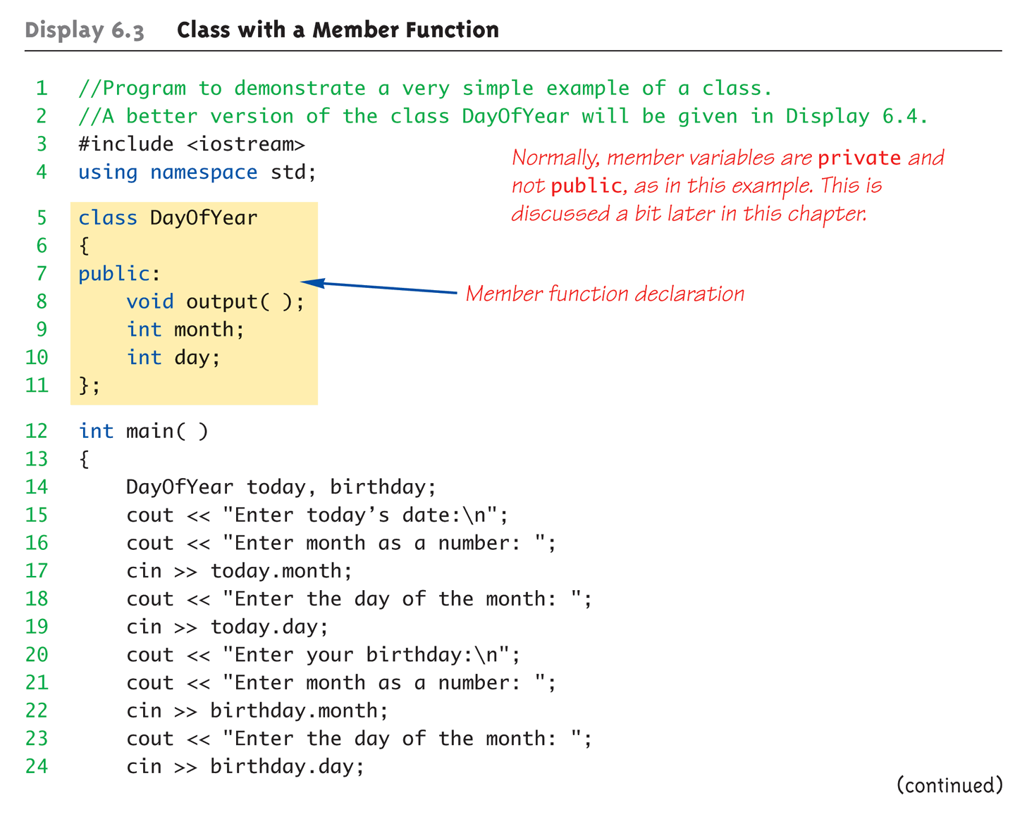
Complete Class Example: Printing out Dates (1 of 4)

Slide 20
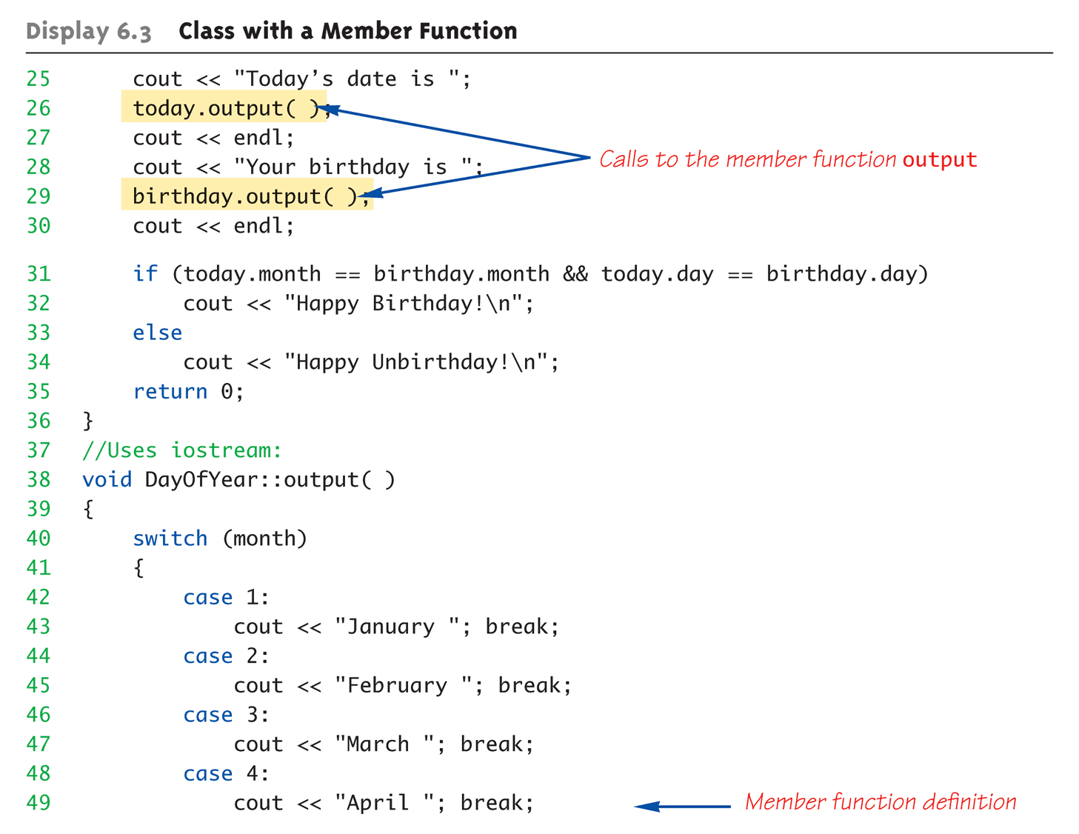
Complete Class Example: Printing out Dates (2 of 4)
Note that month variable is in scope

Slide 21
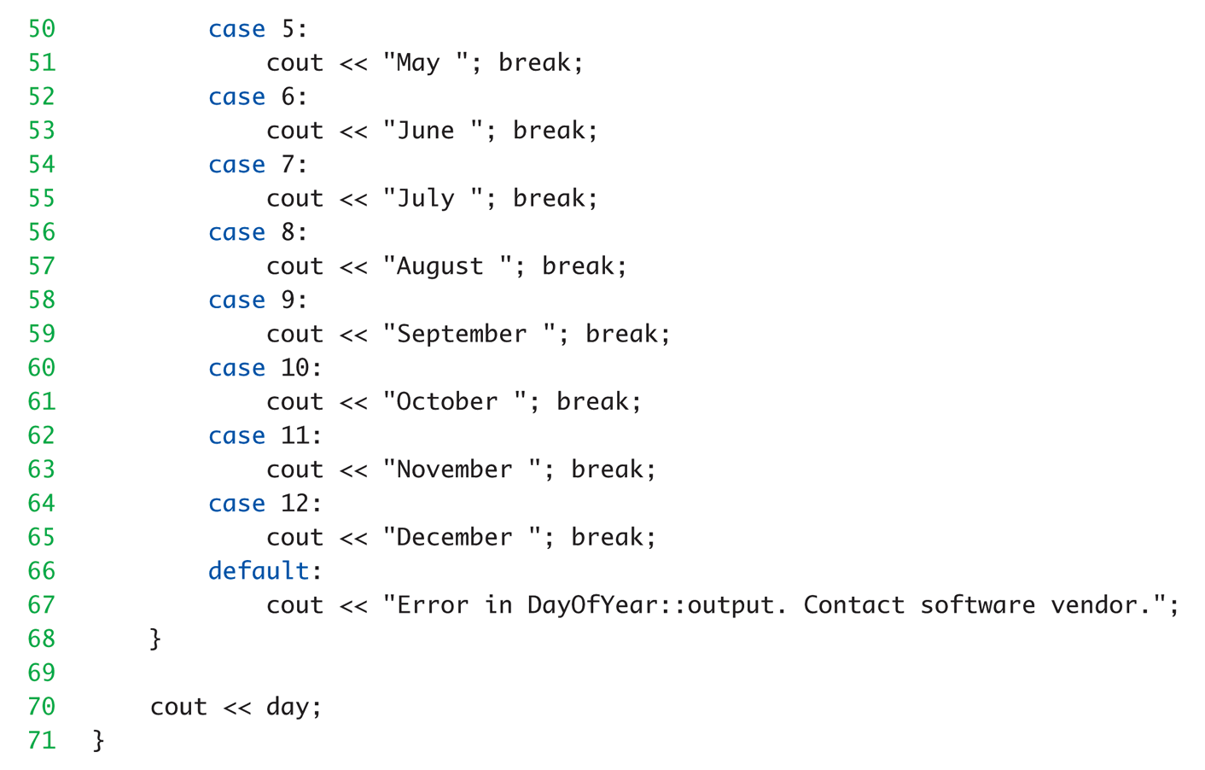
Complete Class Example: Printing out Dates (3 of 4)

Slide 22
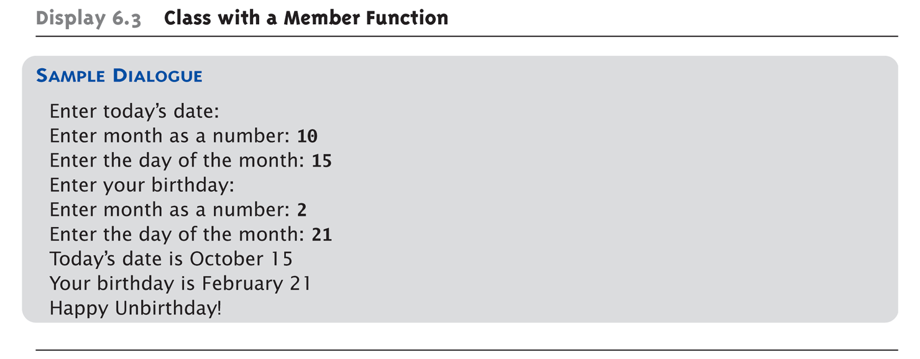
Complete Class Example: Printing out Dates (4 of 4)

Slide 23
Review - . Versus ::
Used to specify "of what thing" they are members
Dot operator specifies member of particular object
Scope resolution operator (::) specifies what class the function definition comes from

Slide 24
A Class’s Place
Class is full-fledged type!
Just like data types int, double, etc.
Can have variables of a class type
We simply call them "objects"
Can have parameters of a class type
Pass-by-value
Pass-by-reference
Can use class type like any other type!

Slide 25
Class Practice
Create a new project in VisualStudio = classesPractice
Declare a student class with data properties
String firstName
String lastName
Int studentID
Double gpa
Specify class method
printName() – cout the first name and last name
In the main() function
Define two student variables and initialize them
Invoke the printName function to display first & last name

Slide 26
Learning Objectives – Intro to OOP
Notes:
Information Hiding
Details of how operations work not known to "user" of class
Data Abstraction
Details of how data is manipulated within ADT/class not known to user
Encapsulation
Bring together data and operations, but keep "details" hidden

Slide 27
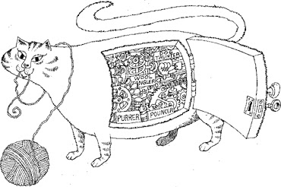
Encapsulation
Means "bringing together as one"
Declare a class → get an object
Object is "encapsulation" of
Data values
Example: int data type has: Data: -2147483648 to 2147483647 (for 32 bit int) Operations: +,-,*,/,%,logical,etc.
Operations on the data (member functions)
Notes:
With Classes WE specify data, and the operations to be allowed on our data!

Slide 28
Private Parts vs Public Parts
Data in class almost always designated private in definition!
Upholds principles of OOP
Hide data from user
Allow manipulation only via operations
Which are member functions
Public items (usually member functions) are "user-accessible“
Basic explanation - http://www.youtube.com/watch?v=Y4_SB96DXEo

Slide 29
Public and Private Example
Modify previous example: class DayOfYear { public: void input(); void output(); private: int month; int day; };
Data now private ➔ Objects have no direct access
Dob.month = 12; // NOT ALLOWED.
cin >> dob.month; // NOT ALLOWED!
Dob.input(); // OK
Convention is that public methods and members are listed first
Hidden data defined later, since others don’t need this

Slide 30
Accessor and Mutator Functions
Object needs to "do something" with its data
Call accessor member functions – AKA “getter”
Allow object to read private data
Simple and controlled retrieval of member data
Mutator member functions – AKA “setter”
Allow object to change private data
Manipulated based on application
Called the “interface” for the class
Notes:
Interface = In C++ → public member functions and associated comments
Implementation of class hidden
Member function definitions elsewhere
User need not see them

Slide 31

What’s In Your Wallet? Encapsulation Example

Slide 32
Naming Conventions
Rules #1, 2, and 3:
1: Always use meaningful names
2: Always use meaningful names
3: Always use meaningful names
Rule #4
Constructors: Name of the class
Mutators: Verbs borrowBook withdraw
Accessors: Nouns length row nRows
could use getLength, getRow, getnRows
could use setBorrow, setWithdraw
Notes:
49
49

Slide 33
Encapsulation Practice
Using previous student example
Make the data elements private
Create public function :
Void student::set(string fName, string lName, int ID, double gpa) {…}
Verify that gpa is between 0 and 4. If not, exit(1)
Set the student objects
S1.set(“YourFirstName”, “yourLastName”, 989111222, 3.5);
Modify printStudent to also show GPA

Slide 34

Constructors
Initialize objects
Set some or all member variables
Other actions possible as well
A special kind of member function
Looks like any other function, but…
Must have same name as the class
No return value
Automatically called when object declared

Slide 35
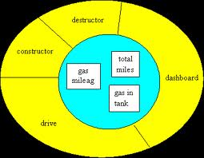
Constructor Definition Example
Class definition with constructor:
class DayOfYear { public: DayOfYear(int monthValue, int dayValue); //Constructor initializes month and day void input(); void output(); … private: int month; int day; }
Must be in public section
Notes:
Notice name of constructor: DayOfYear
Same name as class itself!
Constructor declaration has no return-type
Not even void!
Constructor in public section
It’s called when objects are declared
If private, could never declare objects!

Slide 36
Calling Constructors
Declare objects: DayOfYear date1(7, 4), date2(5, 5);
Objects
Member variables month, day initialized: date1.month → 7 date2.month → 5 date1.dat → 4 date2.day → 5
Two separate variables
Data type → definition

Slide 37
Looks like a function, BUT
Consider:
DayOfYear date1, date2 date1.DayOfYear(7, 4); // ILLEGAL! date2.DayOfYear(5, 5); // ILLEGAL!
Seemingly OK…
CANNOT call constructors like other member functions!

Slide 38
Constructor Code
Constructor definition is like all other member functions: DayOfYear::DayOfYear(int monthValue, int dayValue) { month = monthValue; day = dayValue; }
Can access the private data properties
Note – No return type

Slide 39
Shorthand Definition
Previous definition equivalent to: DayOfYear::DayOfYear( int monthValue, int dayValue) : month(monthValue), day(dayValue) ← {…}
Third line called "Initialization Section"
Body left empty
Preferable definition version

Slide 40
Constructors Should Validate
Not just initialize data
Ensure only appropriate data is assigned to class private member variables
Example
DayOfYear::DayOfYear(int monthValue, int dayValue) {
if ((month < 1) || (month > 12)) {
cout << “Illegal month value”;
exit(1);
} month = monthValue; day = dayValue; }

Slide 41
Constructor Practice
Open up the classes practice project
Convert the previous student set function to a constructor
Make sure to remove any return statement
Change the student variable definition to use the new constructor

Slide 42
Learning Objectives – Intro to OOP
Notes:
Or overloading

Slide 43

Overloading - Defined
This motorcycle can carry
1 Box – No Problem…
2 Boxes – OK
12 Boxes. Problem!!!
Box Contains
Potato Chips. No Problem…
Exercise Weights. Problem!!!

Slide 44
Function Overloading Array Sum Example
Integer Version
int sumarray(int a[], int size) {
int sum = 0;
for (int i = 0; i < size; i++)
sum += a[i];
return(sum); }
Double Version
double sumarray(double a[], int size) {
double sum = 0;
for (int i = 0; i < size; i++)
sum += a[i];
return(sum); }
Main Call
Double total, scores[3] = {1.0, 2.5, 3.5};
Int amount, values[3] = {5, 10 , 15};
Total = sumarray(scores, 3);
Amount = sumarray(values, 3);
Can also change number of parameters
Same function name, but different data types

Slide 45
Overloaded Constructors
Can overload constructors just like other functions
Recall: a signature consists of:
Name of function
Parameter list
Provide constructors for all possible argument-lists
Particularly "how many"

Slide 46
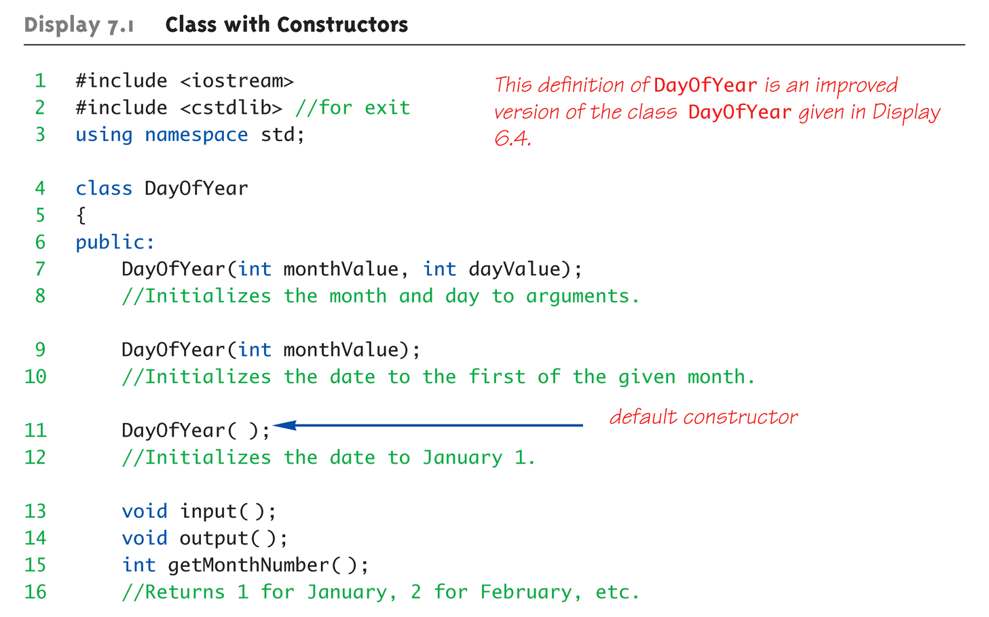
Class Constructors Overload Example (1 of 3)
Note the different versions of constructor

Slide 47
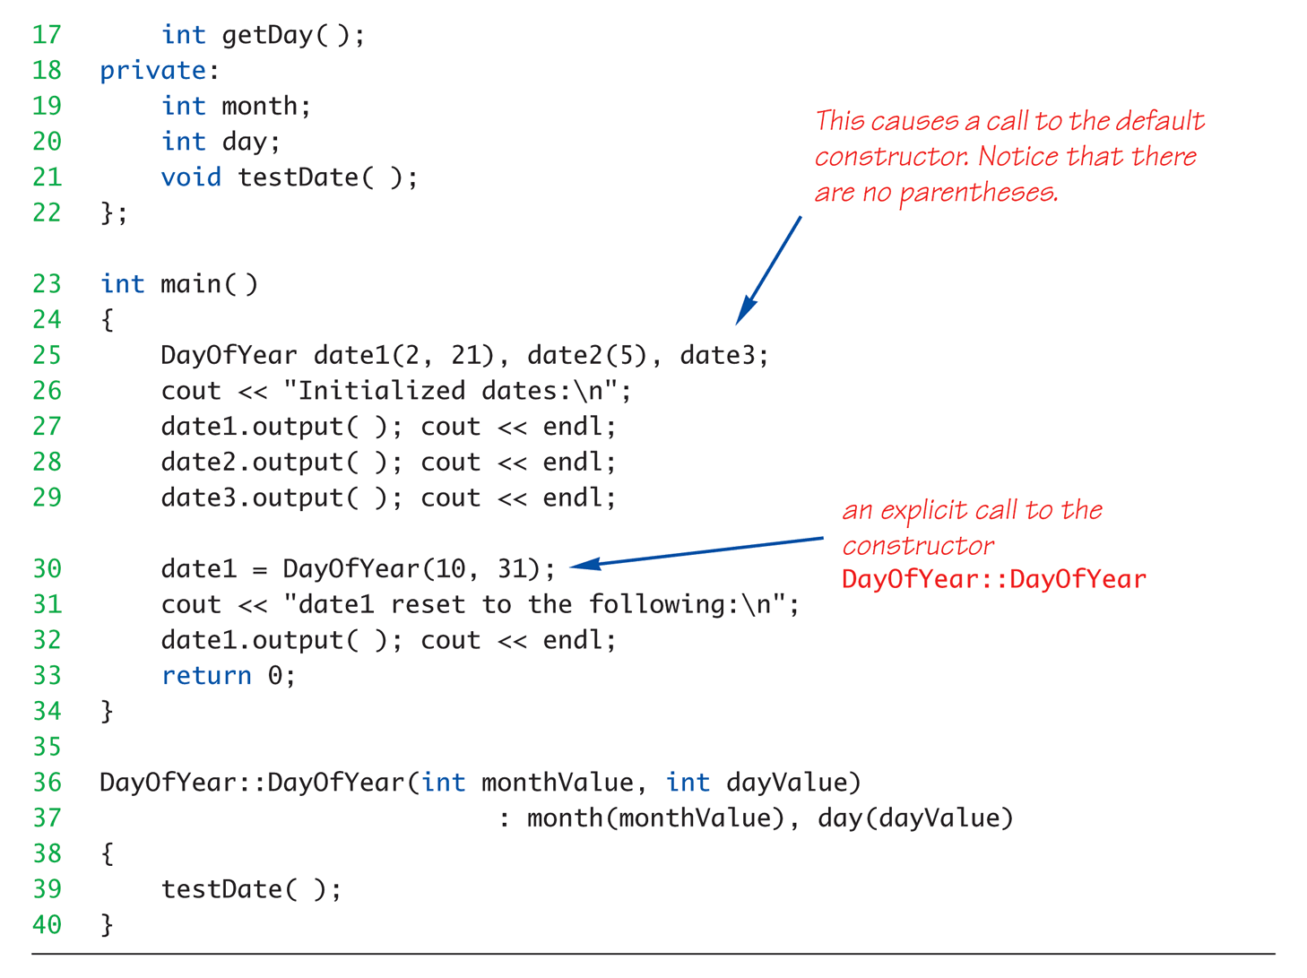
Class Constructors Overload Example (2 of 3)
Shorthand style used to initialize private members

Slide 48
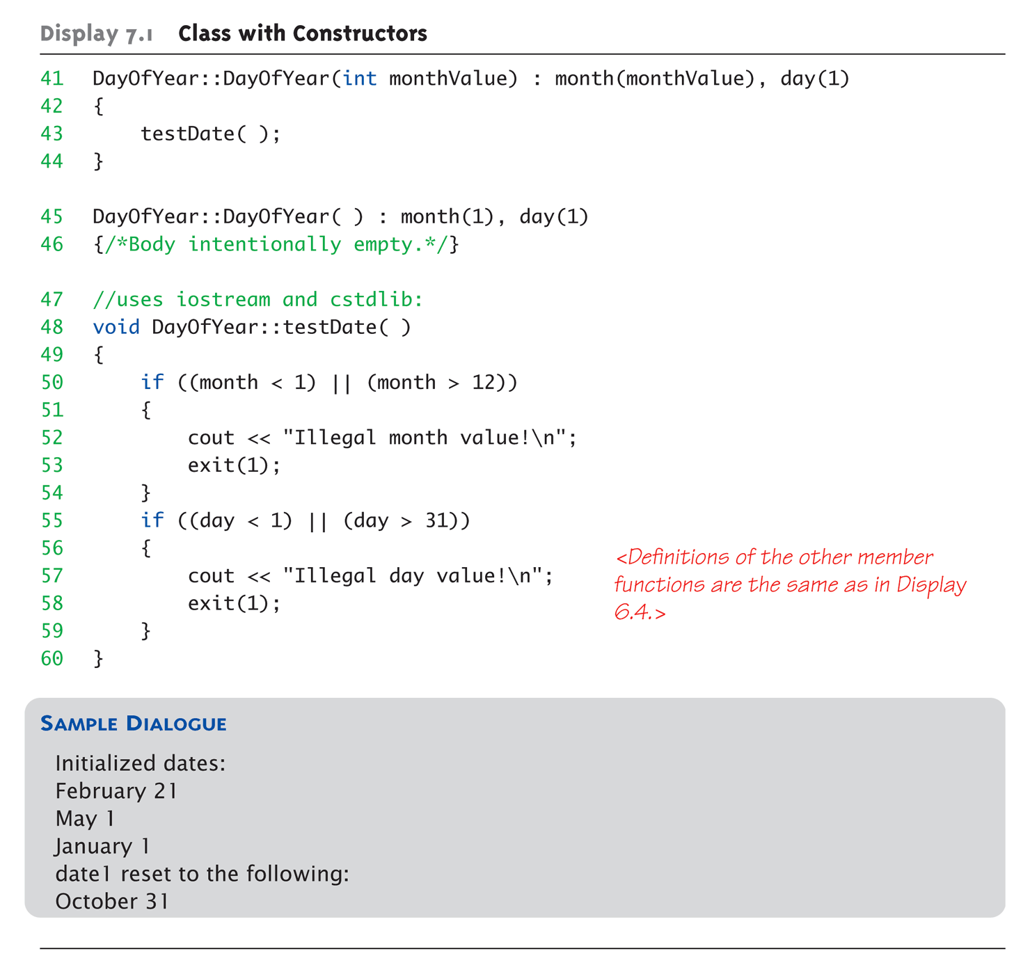
Class Constructors Overload Example (3 of 3)

Slide 49
Constructor with No Arguments
Default constructor
If no default constructor:
Cannot declare: MyClass myObject;
Can be confusing
Standard functions with no arguments:
Called with syntax: callMyFunction();
Including empty parentheses
Object declarations with no "initializers":
DayOfYear date1; // This way!
DayOfYear date(); // NO!
This is really a function declaration / prototype
Notes:
Auto-Generated?
Yes & No
If no constructors AT ALL are defined → Yes
If any constructors are defined → No

Slide 50
Explicit Constructor Calls
Can also call constructor AGAIN
After object declared
Recall: constructor was automatically called then
Can call via object’s name; standard member function call
Convenient method to reset member variables
Example
dayOfYear holiday(7,4);
Holiday = dayOfYear(5,5);
Initial declaration (of Independence)
Reset value to Cinco de Mayo!
Notes:
Explicit constructor call
Returns new "anonymous object"
Assigned back to current object

Slide 51
Default Constructor Practice
Open up the classes practice project
Add a new constructor function without arguments to the student class
Set the member properties
firstName = “Jane”
lastName = “Doe”
ID = 0
GPA = 0.0
Declare student3 variable and print.

Slide 52
Nested Classes
Class member variables can be any type
Including objects of other classes!
Defines a relationship between classes
Need special notation for constructors
So they can call "back" to member object’s constructor

Slide 53
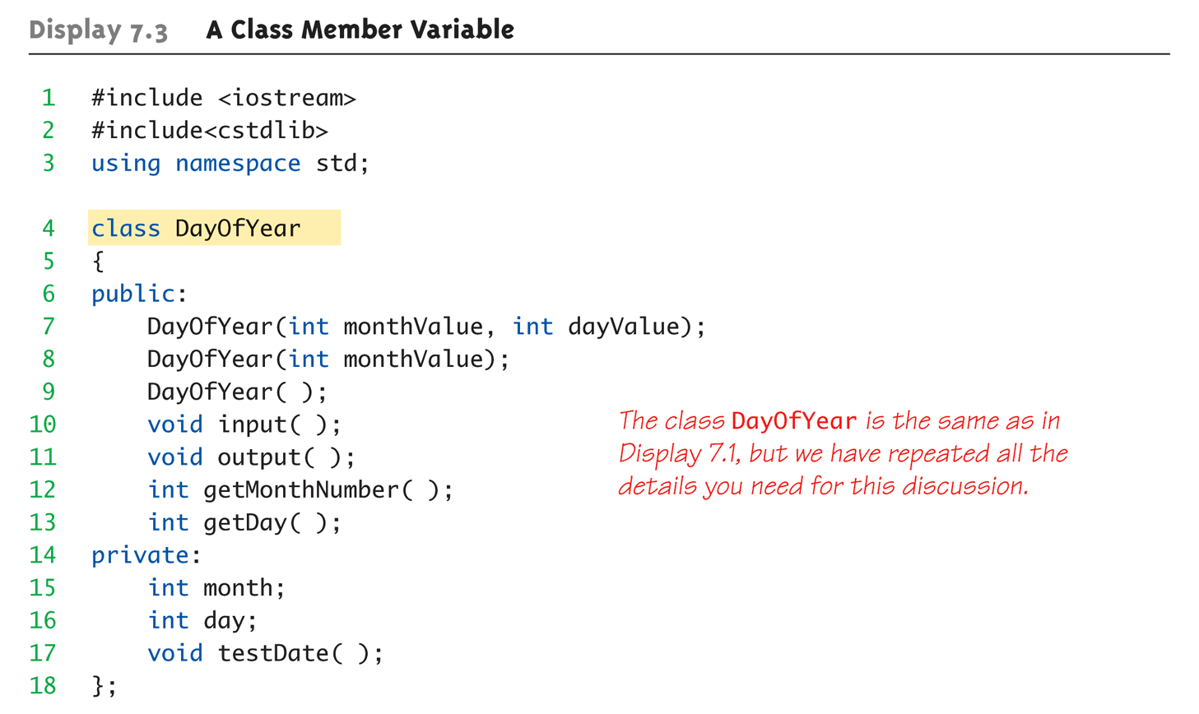
Nested Class Member Example: 1 of 5

Slide 54
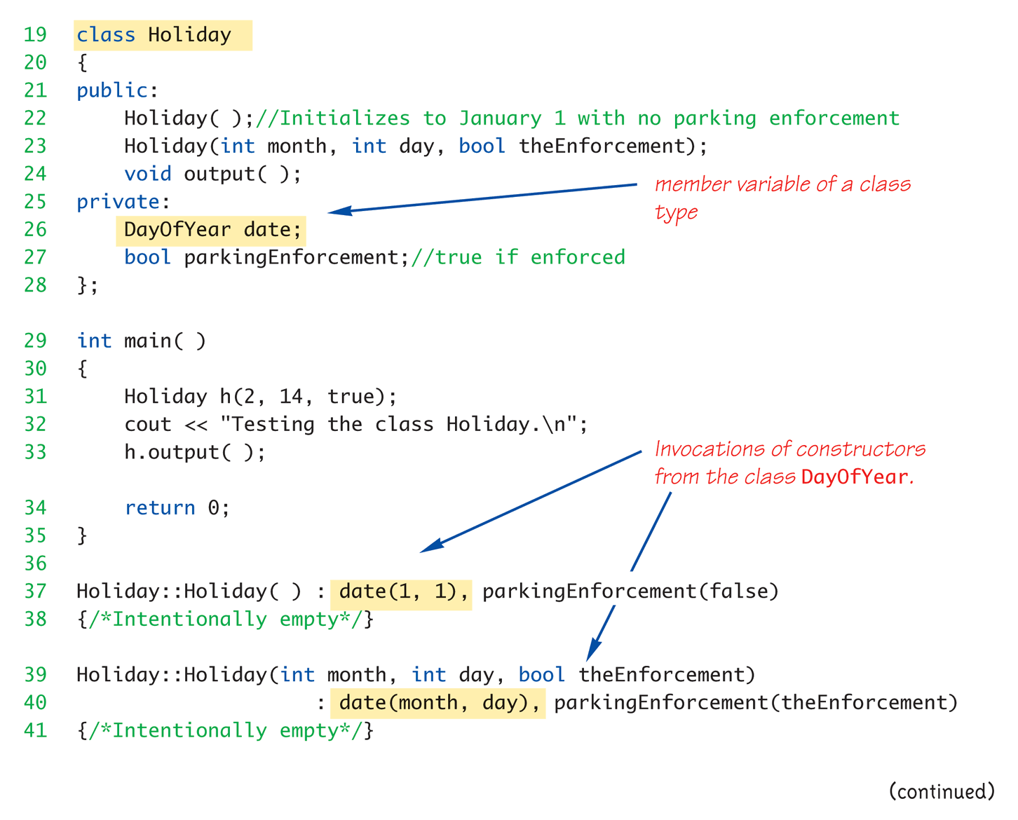
Nested Class Member Example: 2 of 5
New class defined with DayOfYear as nested member

Slide 55
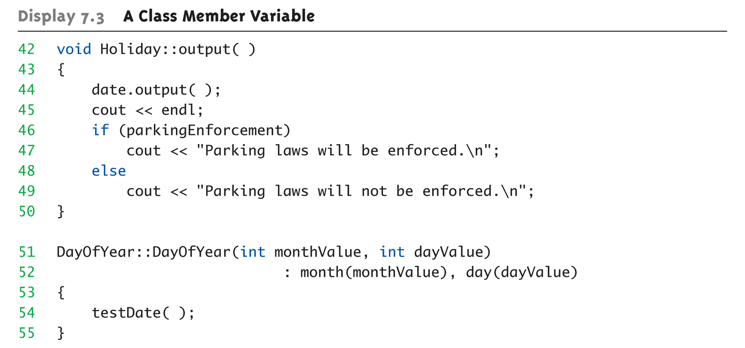
Nested Class Member Example: 3 of 5

Slide 56
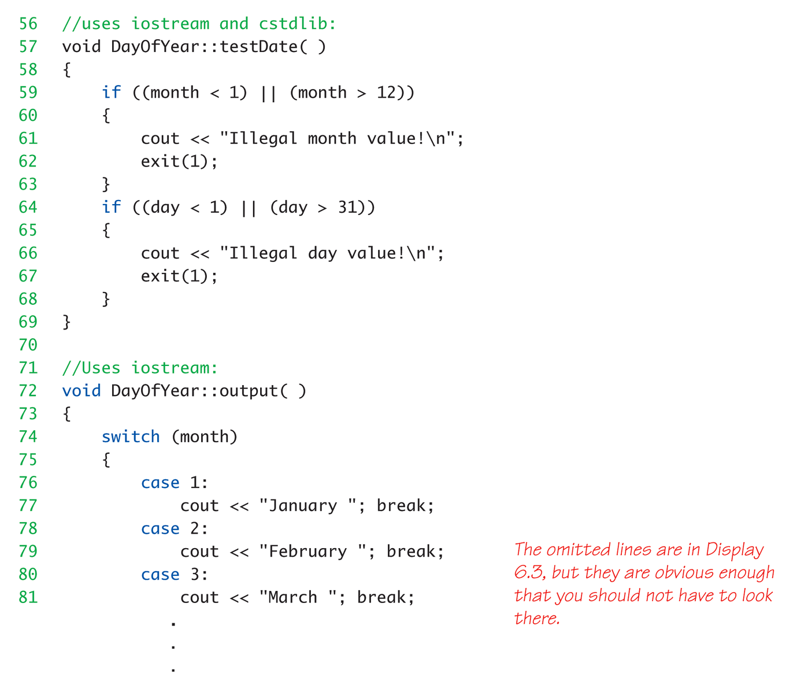
Nested Class Member Example: 4 of 5

Slide 57
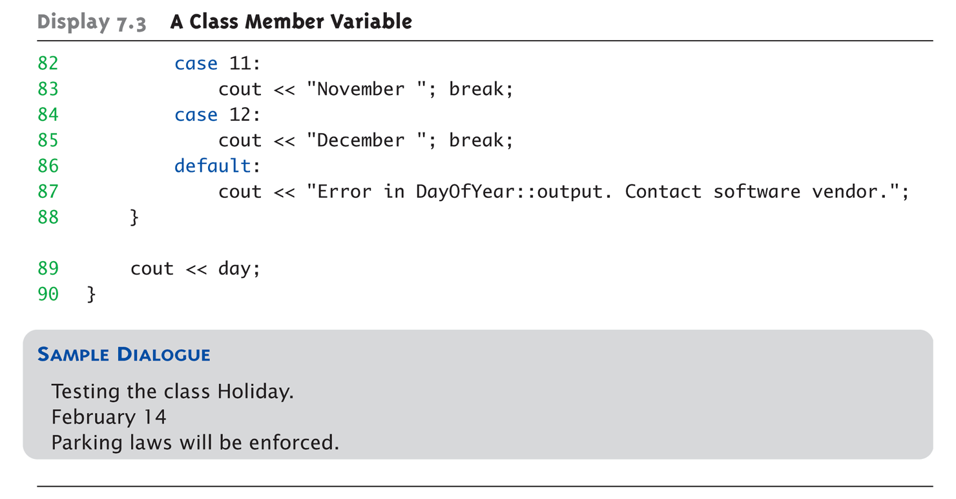
Nested Class Member Example: 5 of 5

Slide 58
Structures versus Classes
Structures
Typically all members public
No member functions
Classes
Typically all data members private
Interface member functions public
Technically, same
Perceptionally, very different mechanisms

Slide 59
Back to Design - Object Pattern
An object pattern is a “best practice” for implementing
The state object patterns describes objects that
Maintain a body of data and provide suitable access to it by other objects and human users
Object patterns help us understand new objects
Many classes have these things in common
private data members store the state of objects
constructors initialize private data members
modifiers alter the private data members
accessors allow us to inspect the current state of an object or to have its state available in expressions.
Notes:
43
43

Slide 60
Key Takeaways
Class = Structure + functions
Also adds private and public parts
What’s the diff? _________________
Focus for programming changes
Before → algorithms center stage
OOP → data is focus
Algorithms still exist
They simply focus on their data
Are "made" to "fit" the data
Interface versus implementation

